Slide 1

Week 1: Data
Data Analytics & Statistical Approaches with Python
Foivos Dimitrakopoulos

Slide 2
Types of Data
Qualitative: The data that approximates and characterizes. Qualitative data can be observed and recorded. This data type is non-numerical in nature.
Quantitative: The value of data in the form of counts or numbers where each data-set has a unique numerical value associated with it. This data is any quantifiable information that can be used for mathematical calculations and statistical analysis.

Slide 3
Discrete Quantitative Data
Discrete or Categorical Data is often integer data that cannot be measured more precisely. In such data values between values are not feasible.
Examples:
Number of Children (People)
Tons of Oil
Number of Stores

Slide 4
Continuous Quantitative Data
Data of numeric type that is precise and can be divided into further units.
Examples:
Heights
Currency
Time
Speed

Slide 5
Binary Data
Binary Data is that which can be placed in one of two mutually exclusive categories.
There are three understandings of binary as a data format.

Slide 6

Binary Data in Statistics
In statistics, binary data is a statistical data type consisting of categorical data that can take exactly two possible values, such as "A" and "B", or "heads" and "tails". As a form of categorical data, binary data is nominal data, meaning they represent qualitatively different values that cannot be compared numerically. However, binary data is frequently converted to count data by considering one of the two values as "success" and representing the outcomes as 1 or 0, which corresponds to counting the number of successes in a single trial: 1 (success) or 0 (failure);

Slide 7
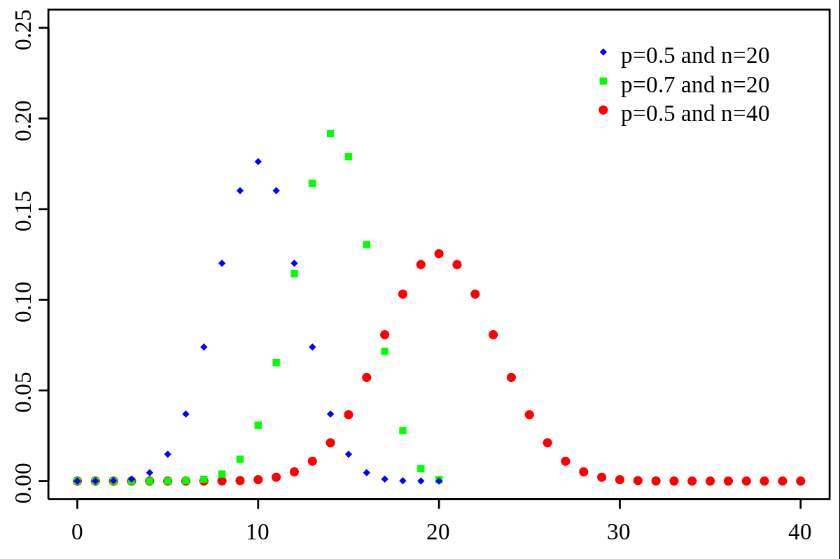
Binary Variables
A binary variable is a random variable of binary type, meaning with two possible values. Independent and identically distributed (i.i.d.) binary variables follow a Bernoulli distribution, but in general binary data need not come from i.i.d. variables. Total counts of i.i.d. binary variables (equivalently, sums of i.i.d. binary variables coded as 1 or 0) follow a binomial distribution, but when binary variables are not i.i.d., the distribution need not be binomial.

Slide 8
Nominal Data
Nominal data is assigned into categories which do not have an implicit rank.
In Nominal data ordering cannot be used to make inferences.

Slide 9
Ordinal Data
This data, ordering has some implicit value such as ratings or categories with implicit ranking.
Examples:
Rating scales
Short-Tall scale

Slide 10
Interval Data
Interval data are a type of numeric data which is measured along a scale, in which each point is placed at equal distance from another. The distance between points is standardized.
Most common numerical data is interval data, especially descriptive data such as temperature etc.

Slide 11
Ratio Data
Ratio data have the same properties as interval data however, 0 is treated as absolute. That means that Ratio data is interval data that only has positive values.
For example, temperature has an arbitrary 0 – height doesn’t.

Slide 12
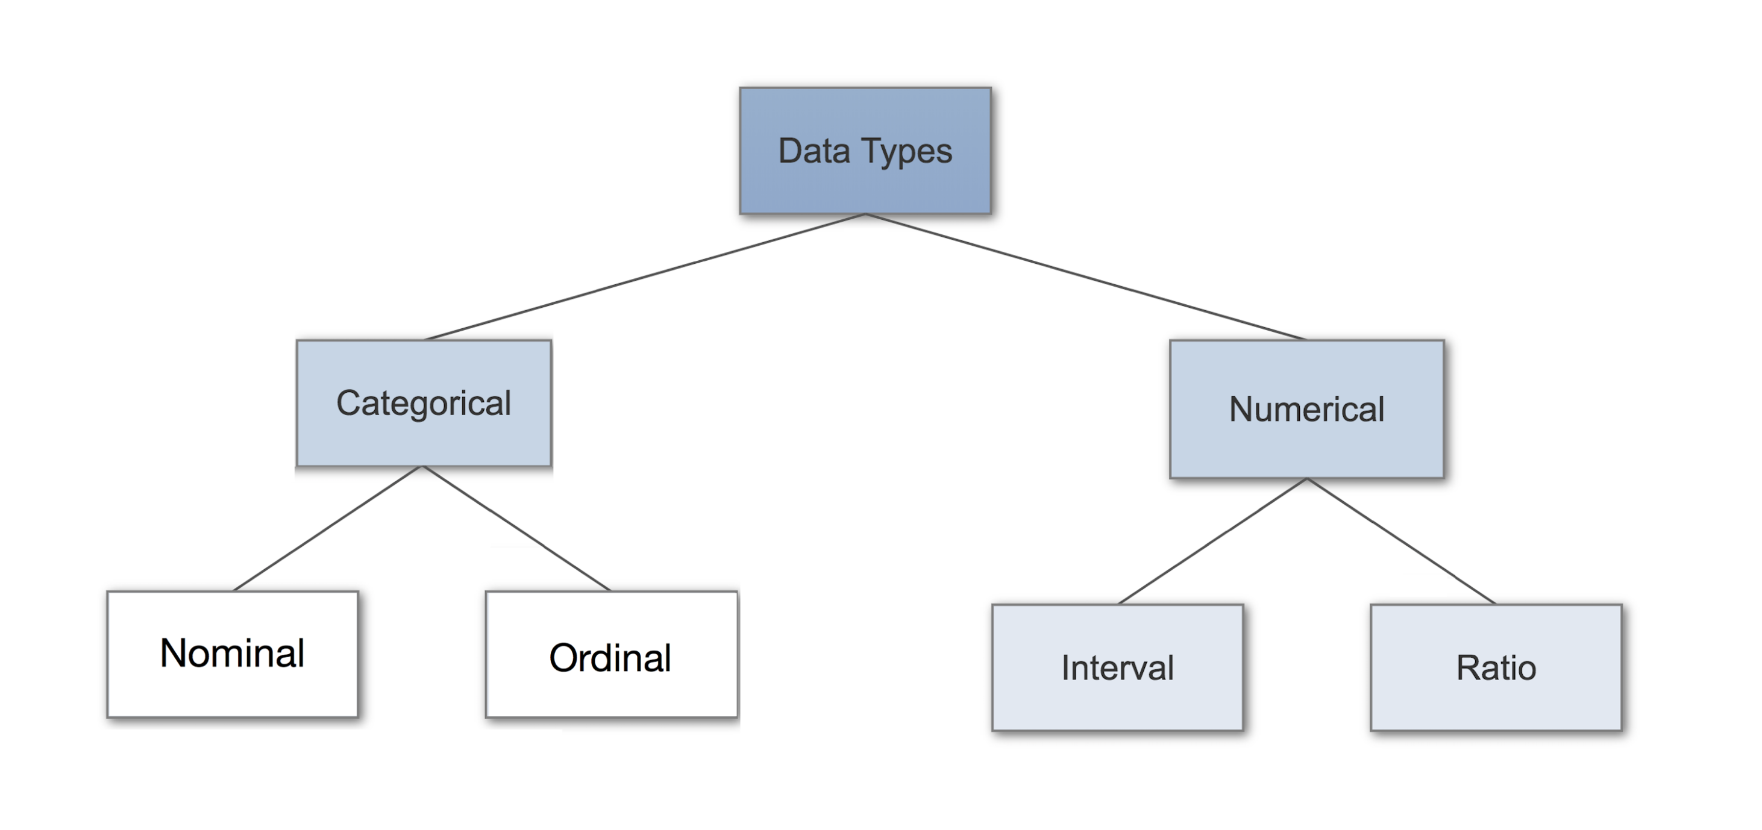

Slide 13
Data analytics is about looking in the right direction.

Slide 14
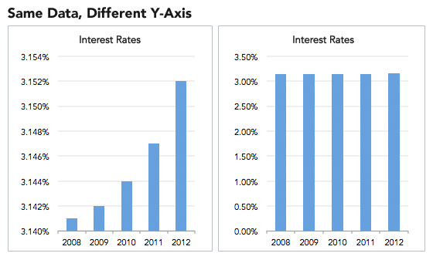
Data Visualisation
Understanding more about the data we are handling means that we can create accurate visualisations of data.
… or create inaccurate visualisations.
Data visualisation serves as a key tool for the derivation of statistical inferences especially by the general population.
There are statistical methods which we can use to verify data significance as well.

Slide 15

Approaching Data
Dataset 1: Mountains
Consider we are interesting in analysing the elevation data of a number of mountains.
How would we approach creating a data inference?
What about the key characteristics of mountain elevation?

Slide 16
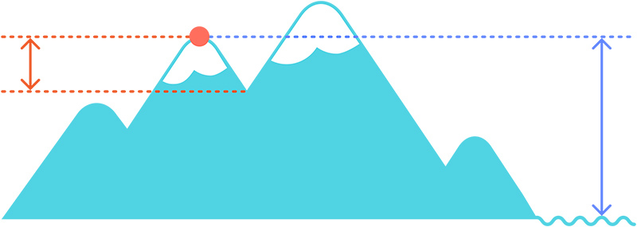
Understanding the data
Summit Elevation: The altitude at the top of the mountain.
Prominence: The altitude of the mountain compared to elevation of surroundings.
Isolation: Distance from a higher peak.

Slide 17
Our Dataset
Name | Elevation (m) | Prominence (m) | Isolation (km)
Olympus | 2917 | 2353 | 254.34
Smolikas | 2637 | 1736 | 74.34
Voras | 2528 | 1758 | 51.17
Ida | 2456 | 2456 | 439.94
Giona | 2510 | 1702 | 154.18
Taigetos | 2405 | 2345 | 109.64
Data from: Peakbagger
Ratio data

Slide 18
Prominence to Isolation Relationships

